Slide 1
Bank Loan Case Study
By Deepak soni

Slide 2
Contents:
Project Description
Approach
Tech-Stack Used
Insights
Result

Slide 3
Project Description:
The main aim of this project is to identify patterns It includes two types of scenarios:
Customers with payment difficulties: These are customers who had a late payment of more than X days on at least one of the first Y installments of the loan.
All other cases: These are cases where the payment was made on time.
This information can be used to make decisions such as denying the loan, reducing the amount of loan, or lending at a higher interest rate to risky applicants. The company wants to understand the key factors behind loan default so it can make better decisions about loan approval.

Slide 4
Approach:
This case study has two enormous data set :The current application and The previous application. Each included several unneeded columns that would be useless for risk assessment, as well as many blank data.
To evaluate this enormous set of data, I first clean the data set using excel formulas and functions find the blanks and proportion of blanks and removed unnecessary columns, and identified some outliers and then begin performing the analysis using formula’s, functions, pivot tables and charts

Slide 5
Tech-Stack Used:
Microsoft Excel 2021 - A spreadsheet editor software used mainly by professionals to enter data in table format, perform computations, plot graphs etc. Here Microsoft Excel is used to filter data and plot graphs to get insights about IMDB MOVIES analysis project.
Microsoft PowerPoint - Microsoft PowerPoint is a powerful presentation software that allows you to create clean and impactful slideshows.

Slide 6
Identify Missing Data and Deal with it Appropriately:
Task: Identify the missing data in the dataset and decide on an appropriate method to deal with it using Excel built-in functions and features.
Solution: Here we use count blank function to identify the blank space in dataset and calculate blank proportion to decide which columns are necessary. If blank proportion is greater than 40% then I have removed those column and blank proportion is less than 40% then used imputation technique to replace the missing data with some substitute values. Here I have used two imputation method that is mean and median.
Formulas: count blank: countblank(column)
Blank proportion: no. of blanks * 100 / total no. of rows
Mean: average(column)
Median: median(column)

Slide 7
Identify Outliers in the Dataset:
Task: Detect and identify outliers in the dataset using Excel statistical functions and features, focusing on numerical variables.
Solution: When dealing with large datasets in Excel, it’s crucial to identify outliers, as they can skew your results and lead to incorrect conclusions.
Having your data organized in a spreadsheet is the first step.
Step two involves sorting your data in ascending or descending order to see if any values stand out visually.
Step three requires you to use the QUARTILE function to calculate Q1 (first quartile) and Q3 (third quartile).
Step four is about calculating the IQR, which is the difference between Q3 and Q1(Q3 – Q1).
Step five involves calculating the lower bound (Q1 - (1.5 * IQR)) and upper bound (Q3 + (1.5 * IQR)) using the IQR.
Any data points that fall below the lower boundary or above the upper boundary are considered outliers.

Slide 8
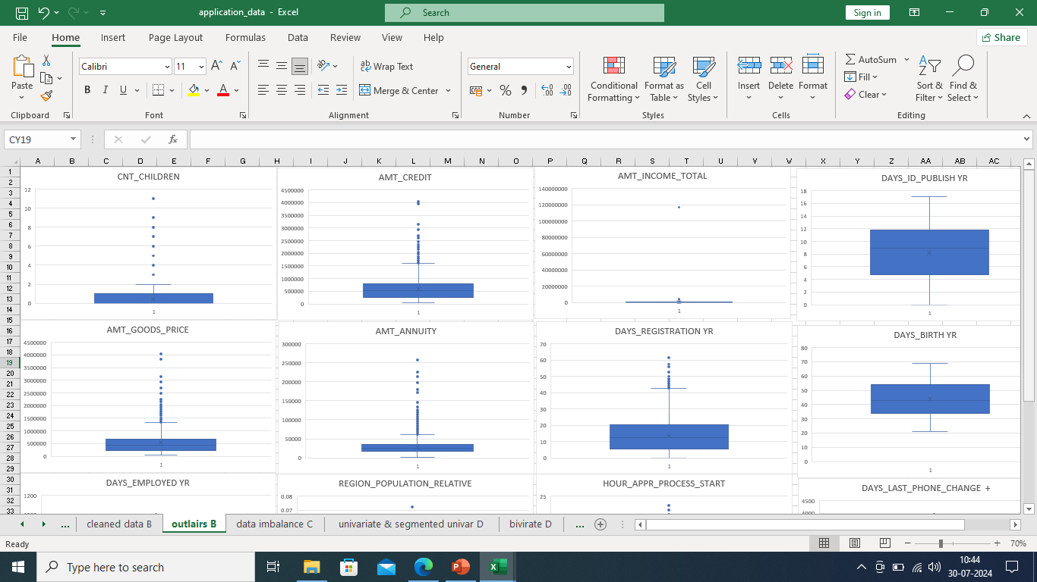
Identified outliers for application data set:

Slide 9
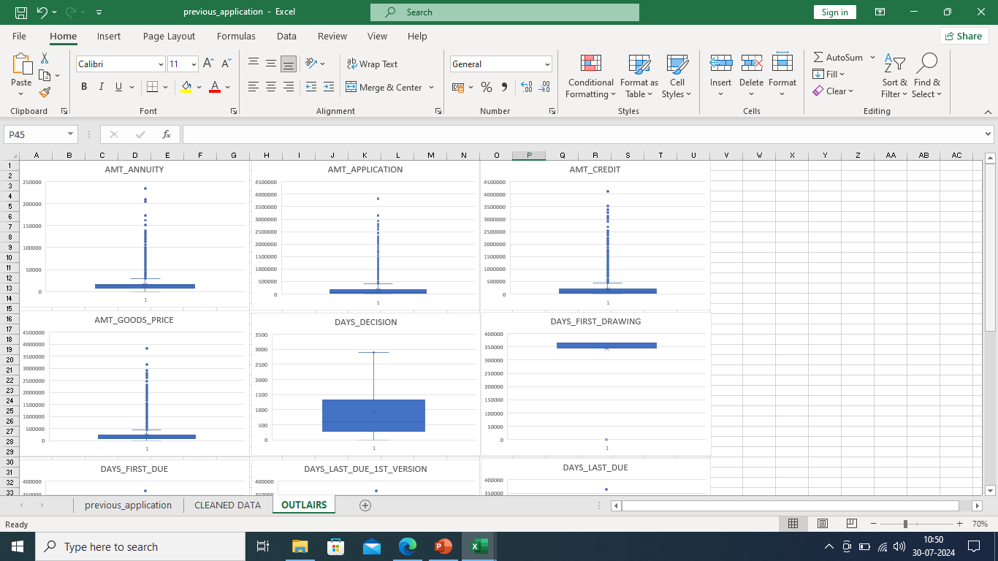
Identified outliers for previous application data set:

Slide 10
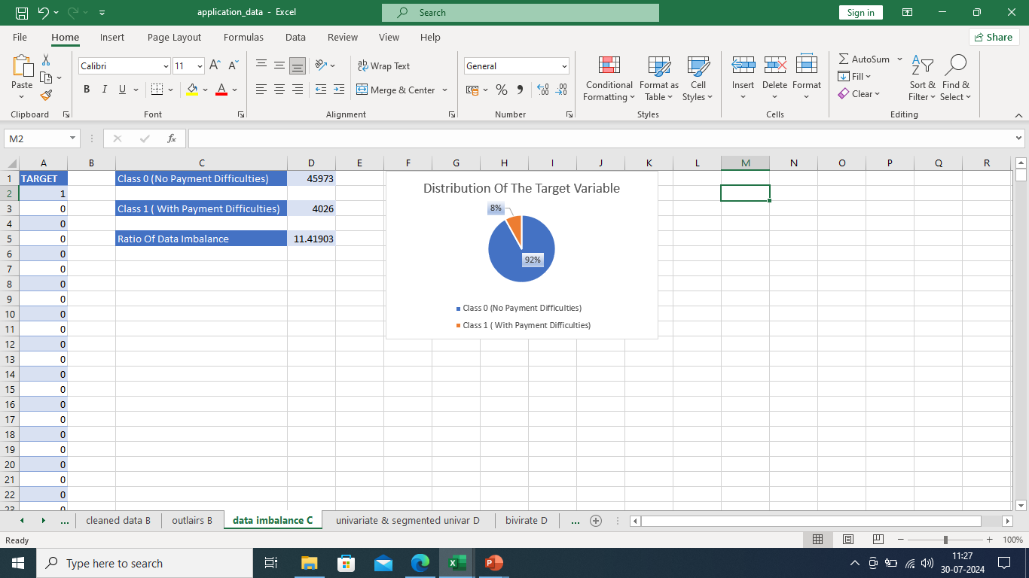
Data Imbalance:
Task: Determine if there is data imbalance in the loan application dataset and calculate the ratio of data imbalance using Excel functions.
Solution: I have used Excel COUNTIF function to calculate the proportions of each class in target variable, and to calculate the ratio of data imbalance i have divided the target variable classes that is (0 with no payment difficulties / 1 with payment difficulties).
After that created a pie chart to visualize the distribution of target variable. In Target variable, Clients with No Payment Difficulties are 92% where as Clients with Payment Difficulties are only 8%.Clearly there is imbalance in data

Slide 11
Univariate, Segmented Univariate, and Bivariate
Task: Perform univariate analysis to understand the distribution of individual variables, segmented univariate analysis to compare variable distributions for different scenarios, and bivariate analysis to explore relationships between variables and the target variable using Excel functions and features.
Solution: Univariate analysis is statistical method to analyze the data with one variable. It involves the examining the distribution of single variable and deriving insights from it. And the term bivariate analysis refers to the analysis of two variables. I have used pivot table and pivot chart to analyze and visualize the data.

Slide 12
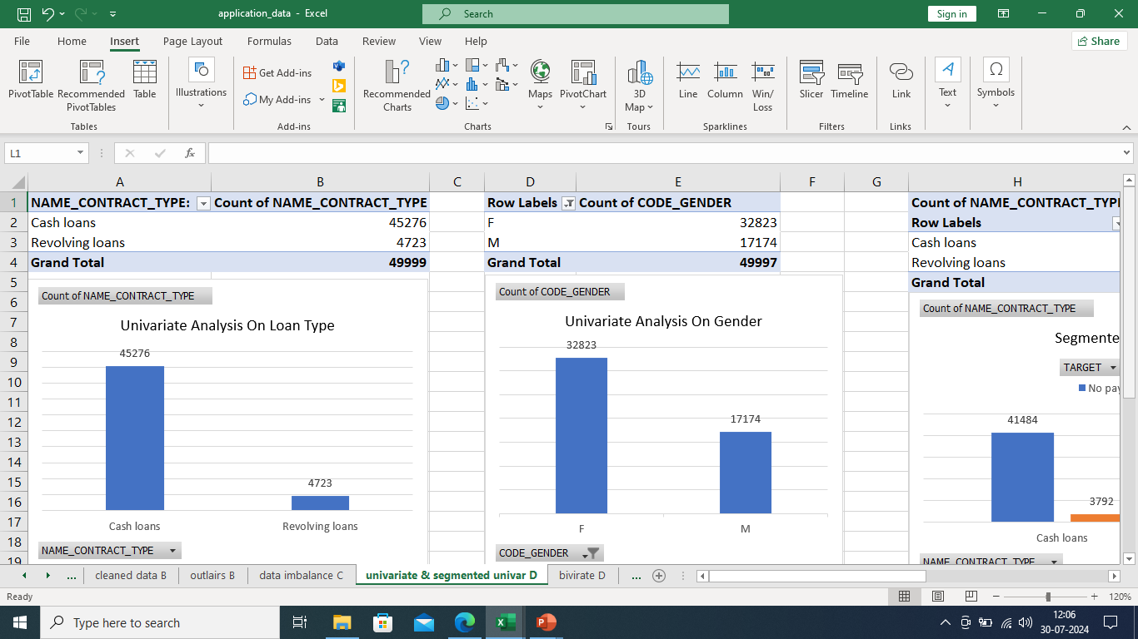
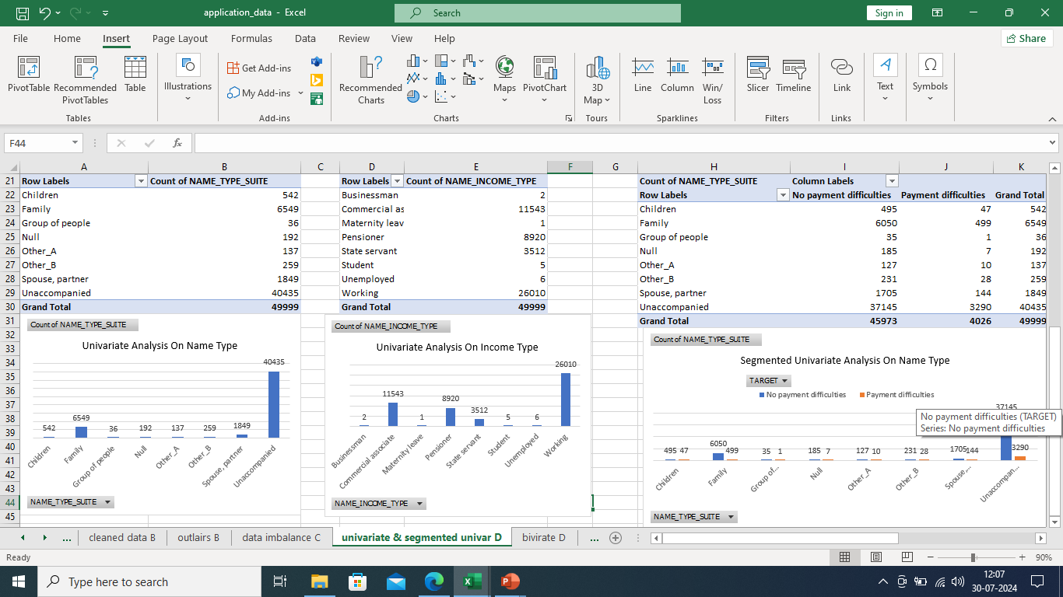
Univariate analysis snaps:

Slide 13
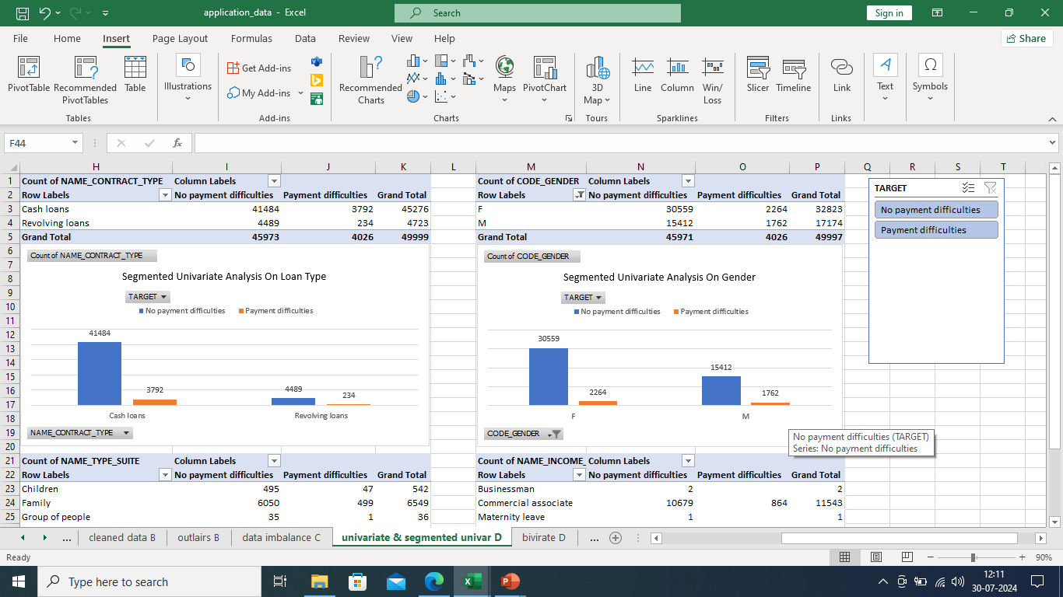
Segmented univariate analysis snaps:

Slide 14
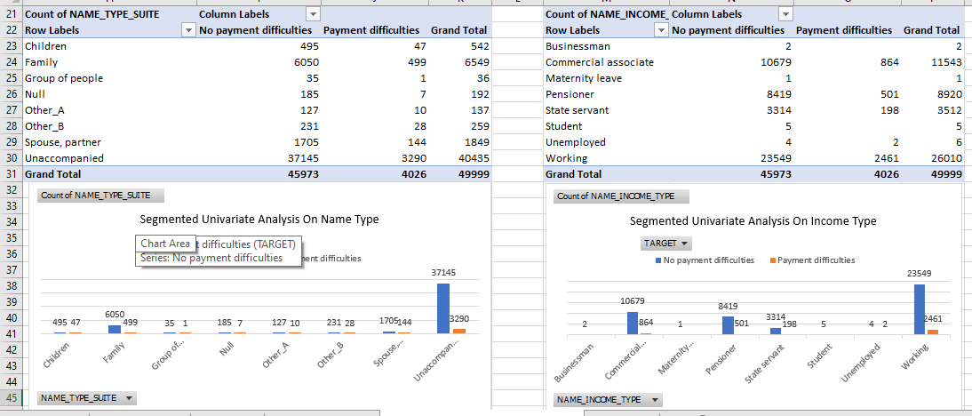
Segmented univariate analysis snaps:

Slide 15
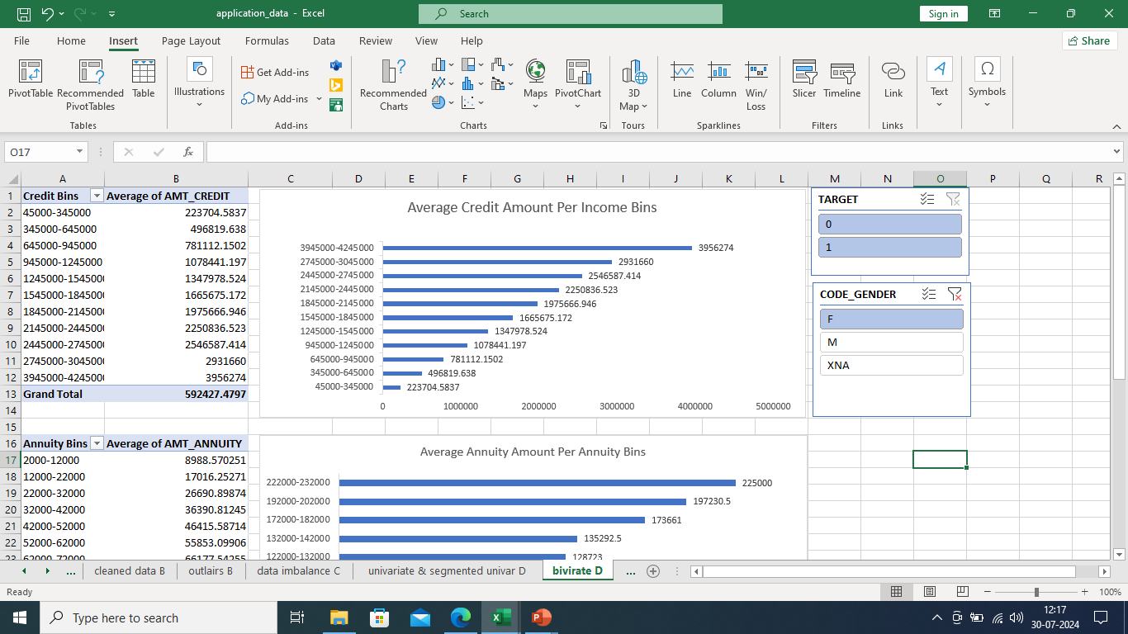
Bivariate analysis snaps:

Slide 16
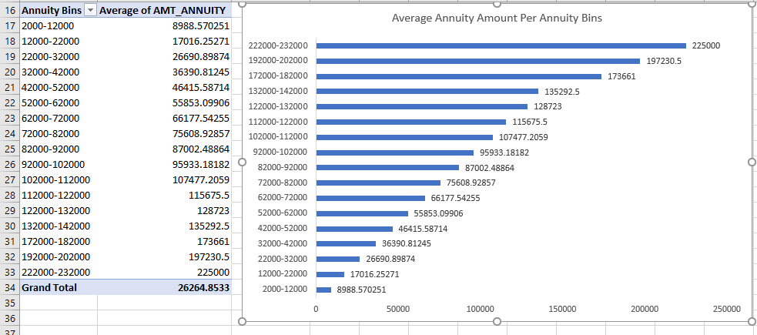
Bivariate analysis snaps:

Slide 17
Identify Top Correlations for Different Scenarios:
Task: Segment the dataset based on different scenarios (e.g., clients with payment difficulties and all other cases) and identify the top correlations for each segmented data using Excel functions.
Solution: The correlation coefficient (a value between -1 and +1) tells you how strongly two variables are related to each other. We can use the CORREL function or the Analysis Tool pack add-in in Excel to find the correlation coefficient between two variables. A correlation coefficient of +1 indicates a perfect positive correlation. A correlation coefficient of -1 indicates a perfect negative correlation. And a correlation coefficient near 0 indicates no correlation. I have calculate correlation coefficients between variables and the target variable within each segment like customer with no payment difficulties and with payment difficulties.

Slide 18
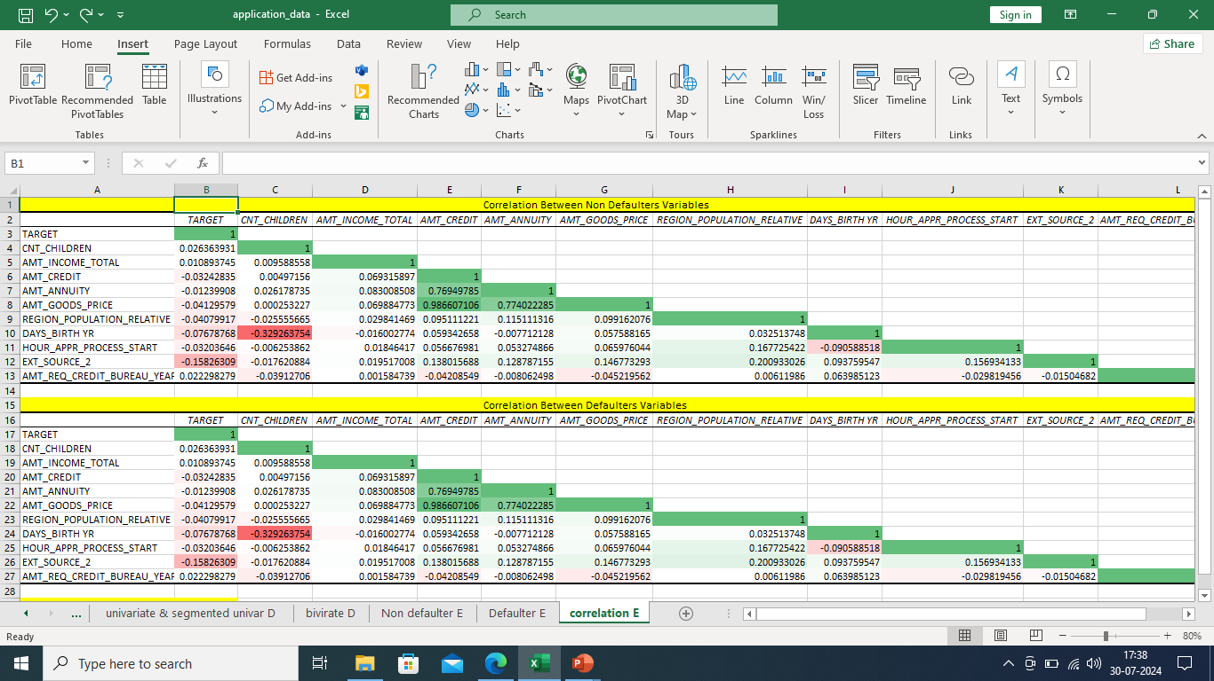
Correlation Matrix for Non-Defaulters

Slide 19

Correlation Matrix for Defaulters

Slide 20
Results:
This case study helped me in learning how to summarize a huge dataset to gain the valuable insights.
This project was very challenging, I implemented the study of correlation between different variables to extract the necessary insights for the clients.
I learned about data imbalance, outliers, driving factors for the datasets.
It helped me in visualizing the huge dataset and summarizing the most important results helpful to the client.

Slide 21
Thank y u

